Slide 1
Yelp Restaurant Analysis: User Engagement & Success Metrics

Slide 2
Problem Statment
In a competitive market like the restaurant industry, understanding the factors that influence business success is crucial for stakeholders. Utilizing the Yelp dataset, this project aims to investigate the relationship between user engagement(reviews, tips, and check-ins) and business success metrices (review count, ratings) for restaurants.

Slide 3
Research Objectives
Quantity the correlation between user engagement(reviews, tips, check-ins) and review count/average star rating: This will help us determine if restaurants with higher user engagement experience a corresponding increase in reviews and ratings.
Analyze the impact of sentiment in review count and average star rating: We will Investigate if positive sentiment in reviews and tis translate to higher star ratings and potentially influences the total number of review left.

Slide 4
Data Overview
This dataset is a small part of the Yelp data and contains information about businesses in 8 major cities in the USA and Canada.
The original data was provided by Yelp in JSON format.
There are five main JSON files: Business, Review, User, Tip, and Check-in.
All JSON files are saved in a database so the data can be easily accessed and analyzed.

Slide 5
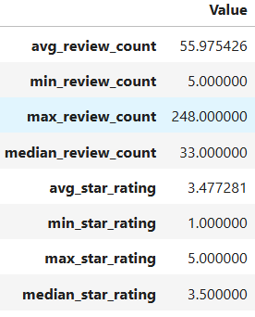
Analysis and Findings
Out of 150k businesses, 35k are open restaurants included in this analysis.
A table shows restaurant success using number of reviews and average ratings.

Slide 6
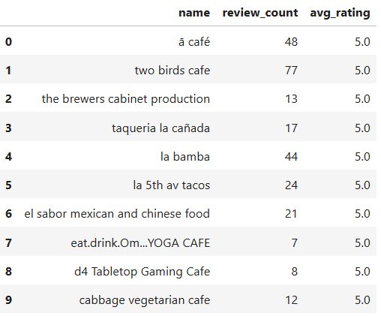
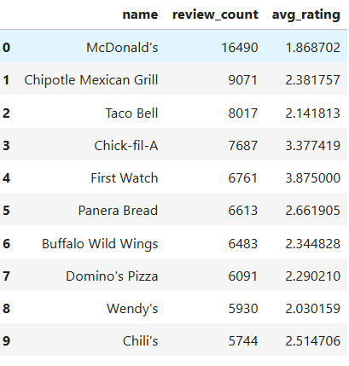
Highest Rating
Highest Review Count
Higher ratings do not guarantee a Higher review count and Vice Versa.
Success of Restaurants is not solely determined by ratings or review counts.

Slide 7
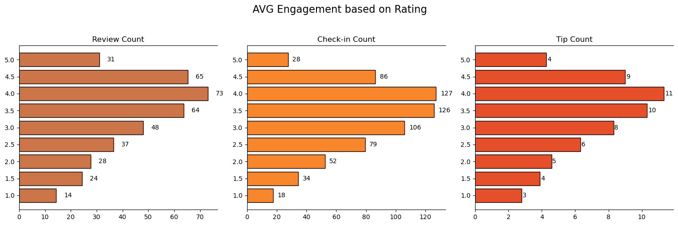
Do restaurants with higher engagement tend to have higher ratings?
As restaurant ratings go from 1 star to 4 stars, the number of reviews, check-ins, and tips usually increases.
Restaurants with 4-star ratings get the highest customer engagement.
Engagement drops at 5-star ratings, possibly because fewer people visit these places or only a small group of very satisfied customers go there.

Slide 8
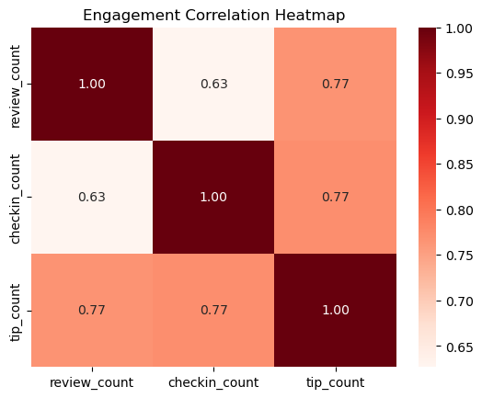
Is there any correlation between the number of reviews, tips, and check-ins for a business?
Reviews, tips, and check-ins are closely connected, meaning that when customers are active in one way, they are often active in other ways too.
Businesses should focus on improving all types of customer engagement because increasing one type of activity can help increase the others and improve overall visibility.

Slide 9
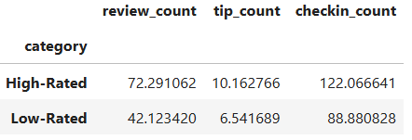
Is there any difference in the user engagement between high-rated and low-rated businesses?
Data indicates a clear correlation between higher ratings and increased user engagement across reviews, tips and check-ins.
This pattern underscore the importance of maintaining high service and quality standards, as these appear to drive more reviews, check-ins, and tips, which are critical metrics of customer engagement and satisfaction.

Slide 10
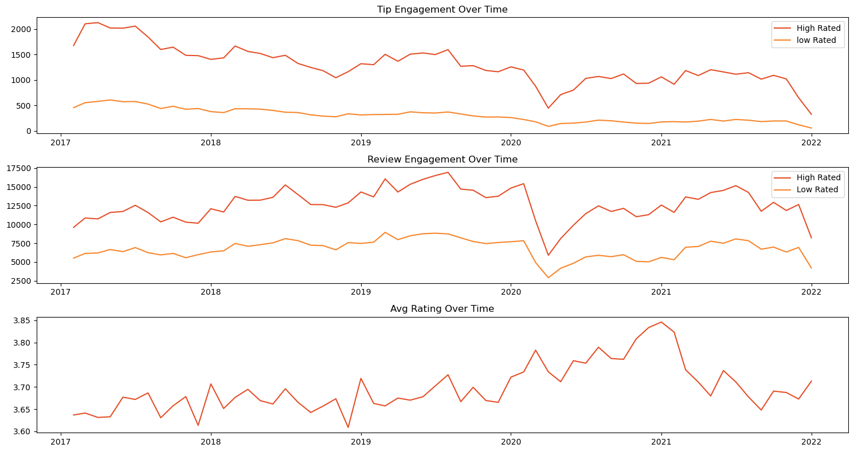
Are there any patterns in user engagement over time for successful businesses compared tot less successful ones
Restaurants with higher ratings (above 3.5 stars) usually show steady or increasing customer activity over time.
This steady engagement means customers stay interested and are generally satisfied with these restaurants.

Slide 11
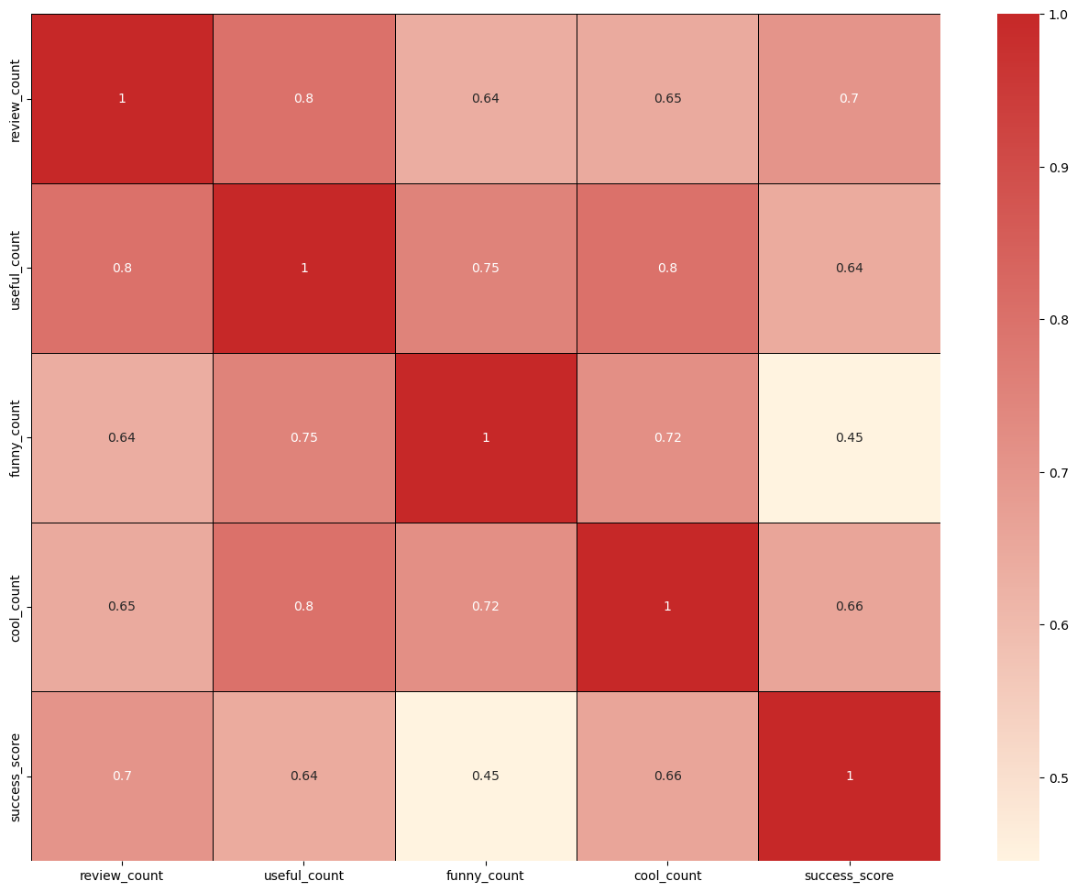
How does the sentiment of reviews and tips (useful, funny, cool) correlate with the success metrics of restaurants?
“useful”, “funny” and “cool” are attributes associated with user reviews. They represent the feedback provided by users about the usefulness, humor, or coolness of a particular review.
Higher counts of useful, funny, and cool reviews suggest greater user engagement and satisfaction, which are key factors contributing to a restaurant’s success

Slide 12
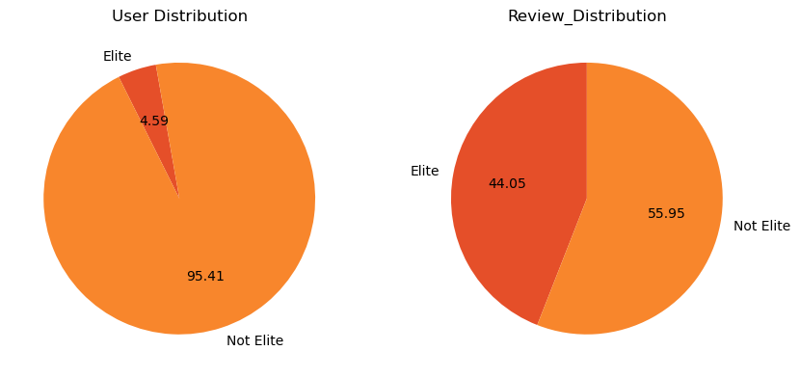
Is there any difference in engagement of elite users and non elite users?
Elite users are individuals who have been recognized and awarded “Elite” status by Yelp for their active and high-quality contributions.
Elite users, despite being significantly fewer in number, contribute a substantial proportion of the total review count compared to non-elite users.
Establishing a positive relationship with elite users can lead to repeat visits and loyalty, as they are more likely to continue supporting businesses they have had good experiences with.

Slide 13
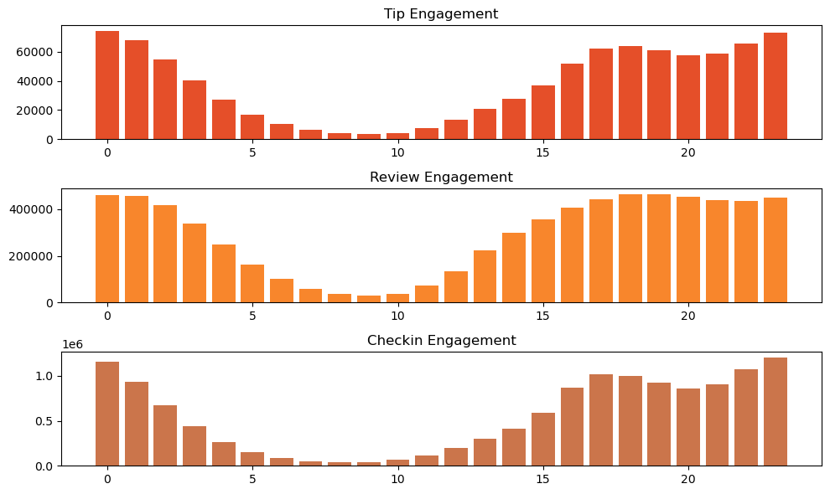
Busiest Hours
The busiest hours for restaurants, based on user engagement, span from 4 pm to 1 am
Knowing the peak hours allows businesses to optimize their staffing levels and resource allocation during these times to ensure efficient operations and quality service delivery
The concentration of user engagement during the evening and night hours suggests a higher demand for dinning out during these times, potentially driven by factors such as work schedules, social gatherings, and leisure activities.

Slide 14
Recommendations
By looking at customer engagement, review sentiment, busy hours, and elite users, businesses can make better decisions to improve their success.
Working with elite users can help promote the business, increase visibility, and attract more customers.
Businesses can change their opening hours or run special offers during busy times to meet higher customer demand.
Restaurants that are not doing well should focus on increasing customer engagement by improving service and responding to feedback.
Cities with high success scores offer good opportunities for restaurant chains to expand or improve their presence.

